Slide 1
Graph Partitioning

Slide 2
Outline
Graph partitioning
The Kernighan-Lin algorithm
Spectral partitioning
Community detection
Spectral modularity maximization
Other algorithm for community detection

Slide 3
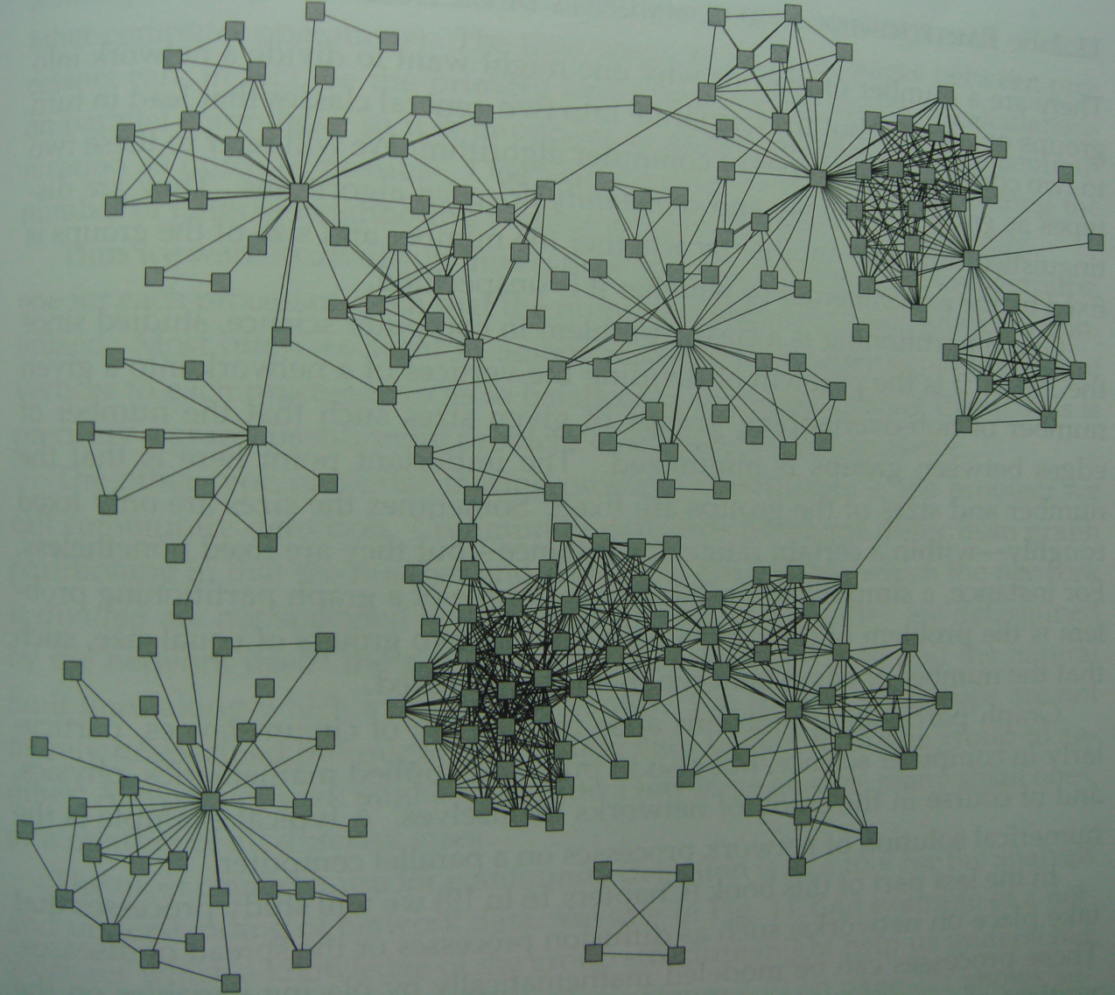
Network of coauthorships in a university department

Slide 4
Graph Partitioning and Community Detection
Graph partitioning and community detection refer to the division of the vertices of a network into groups, clusters, or communities according to the pattern of edges in the network.
The ability to discover groups or clusters in a network can be a useful tool for revealing structure and organization within networks at a scale larger than that of a single vertex.

Slide 5
Graph Partitioning and Community Detection
Graph partitioning
We know the number and size of the groups into which the network is to be split.
Best division
Community detection
The number and size of groups is determined by the network itself and not by the experimenter.
Admit the possibility that no good division of network exists.

Slide 6
Graph Partitioning and Community Detection
Graph partitioning is usually to find the best division of a network, regardless of whether any good division exists.
Community detection is more often used as a tool for understanding the structure of a network.

Slide 7
Graph Partitioning
Why Partitioning is Hard?
The number of ways of dividing a network of vertices into two groups of and vertices respectively is .
Approximating the factorials using Stirling’s formula and making use of the fact that , we get

Slide 8
Graph Partitioning
If we want to divide a network into two parts of equal size the number of different ways to do it is roughly
So the amount if time required to look through all of these divisions will go up roughly exponentially with the size of the network.

Slide 9
The Kernighan-Lin Algorithm
The number of edges between groups is called the cut size.
Algorithm :
1. We start by dividing the vertices of our network into two groups of their required sizes in any way we like. Then, for each pair of vertices such that lies in one of the groups and in the other.

Slide 10
The Kernighan-Lin Algorithm
We calculate how much the cut size between the groups would change if we were to interchange i and j, so that each was placed in the other group.
2.The process is then repeated, but with the important restriction that each vertex in the network can only be moved once.
3.Swapping on each step that pair most decreases the number of edges between two groups until eventually there are no pairs left to be swapped.

Slide 11
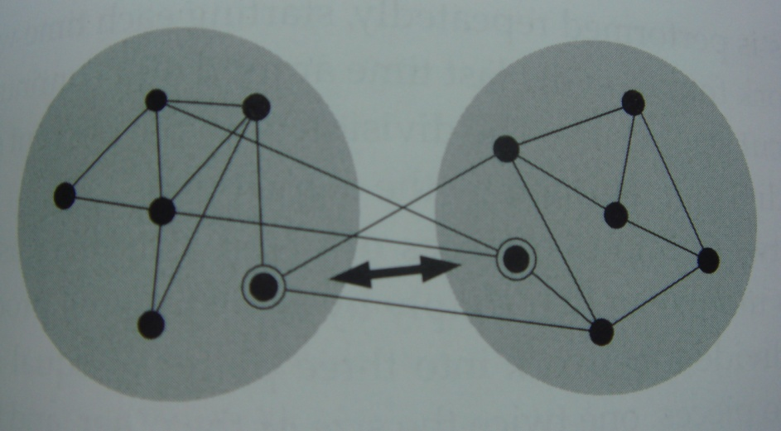
The Kernighan-Lin Algorithm
The algorithm starts with any division of the vertices of a network into two groups(shaded) and then search for pairs of vertices(pair highlighted), whose interchange would reduce the cut size between groups.

Slide 12
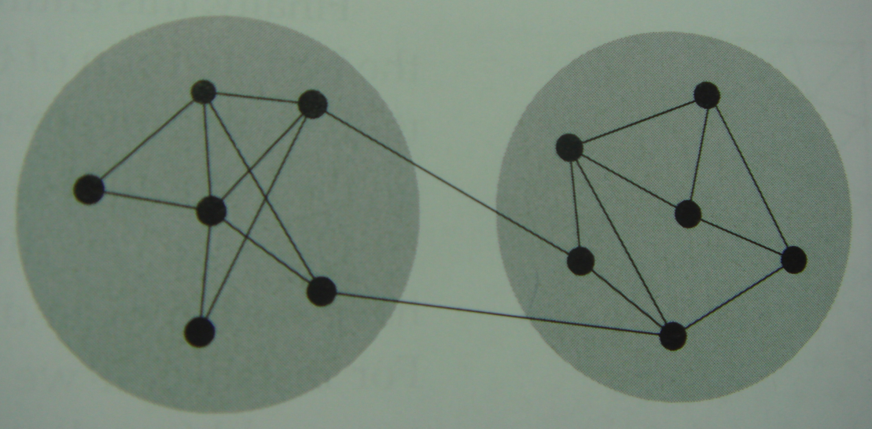
The Kernighan-Lin Algorithm
The same network after interchange of the two vertices.

Slide 13
The Kernighan-Lin Algorithm
The primary disadvantage of the Kernighan-Lin algorithm is that it is quite slow.
There are O(n) swaps in the worst case.
Each swap requires evaluating the cut size of O(n²) pairs.
The evaluation of the change of the cut size is proportional to the average degree.
The total time for one round of the algorithm is
( : the total number of edges in the network)

Slide 14
Spectral Partitioning
Spectral Partitioning method : use the matrix properties of the graph Laplacian.
We describe the spectral partitioning method for the graph bisection problem, i.e., the problem of dividing a graph into two parts of specified sizes.

Slide 15
Spectral Partitioning
Consider a network of n vertices and m edges and a division of that network into two groups, which we will call group and group .
The number of edges running between the two groups :

Slide 16
Spectral Partitioning
Then
Rewrite as

Slide 17
Spectral Partitioning
where is the degree of vertex as usual, is the Kronecker delta, and we have made use of the fact that
and

Slide 18
Spectral Partitioning
where is the vector with elements .
The expression gives us a matrix formulation of the graph partitioning problem. The matrix specifies the structure of our network, the vector s defines a division of that network into groups, and our goal is to find the vector that minimizes the cut size for given .

Slide 19
Spectral Partitioning
The allowed values of the are actually subject to two constraints. Each individual one is allowed to take only the values . The numbers of them that are equal to and respectively must equal the desired sizes of the two groups.
If those two sizes are and .

Slide 20
Solving the constrained optimization problem
Define the new vector

Slide 21
Spectral Partitioning
In other words, is an eigenvector of the Laplacian with eigenvalue .

Slide 22
Spectral Partitioning
Thus the cut size is proportional to the eigenvalue . Given that our goal is to minimize , this means we should choose to be the eigenvector corresponding to the smallest allowed eigenvalue of the Laplacian.
All the eigenvalues of the Laplacian are non-negative.
The smallest one is the zero eigenvalue that corresponds to the eigenvector .

Slide 23
Spectral Partitioning
The eigenvector (1,1,…,1) corresponds to no partition at all.
The best one can do is to choose the second lowest eigenvalue and its corresponding eigenvector.

Slide 24
Relaxation of the constrained optimization problem
( )
Let us do the best we can and choose to be as close as possible to our ideal value subject to its constraints, which we do by making the product as large as possible.

Slide 25
Spectral Partitioning
Final Algorithm :
1. Calculate the eigenvector corresponding to the second smallest eigenvalue of the graph Laplacian.
2. Sort the elements of the eigenvector in order from largest to smallest.
3. Put the vertices corresponding to the largest elements in group , the rest in group , and recalculate the cut size.

Slide 26
Spectral Partitioning
4. Then put the vertices corresponding to the smallest elements in group , the rest in group , and recalculate the cut size. (this is needed because the eigenvector could be x or –x)
5. Between these two divisions of the network, choose the one that gives the smaller cut size.
An advantage of the spectral approach is its speed.

Slide 27
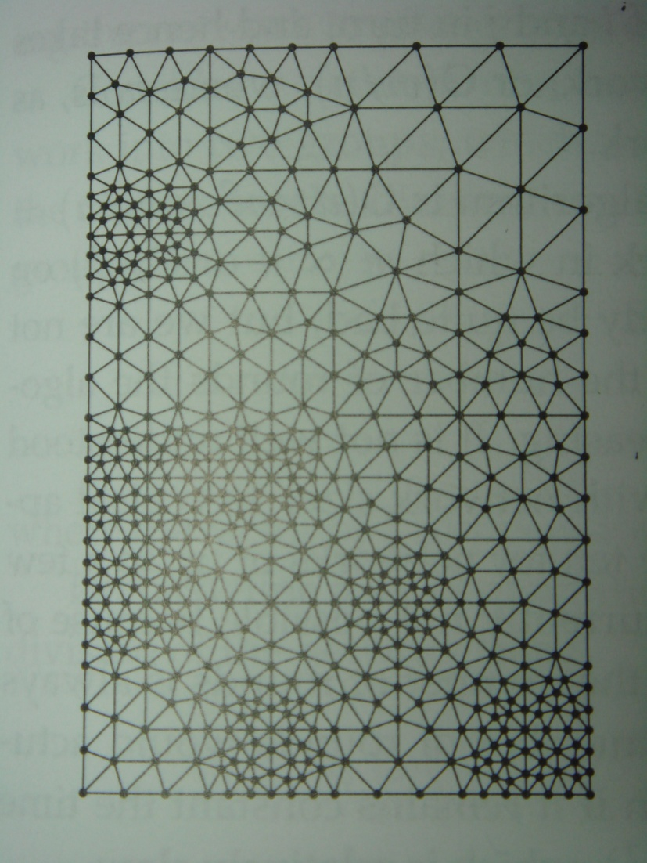
Spectral Partitioning
A mesh network of 547 vertices of the kind commonly used in finite element analysis.

Slide 28
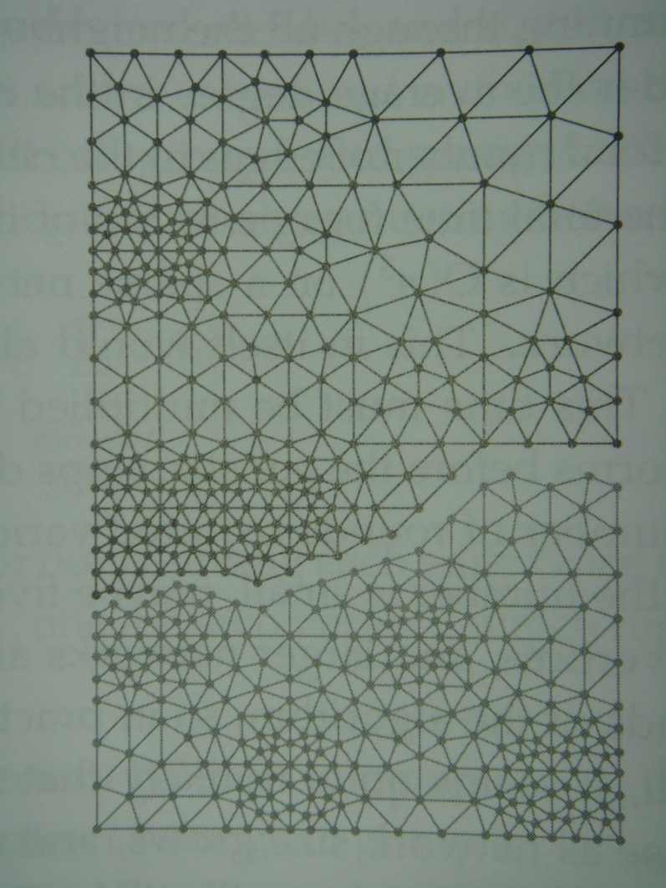
Spectral Partitioning
The edges removed indicate the best division of the network into parts of 273 and 274 vertices found by the Kernighan-Lin algorithm.

Slide 29
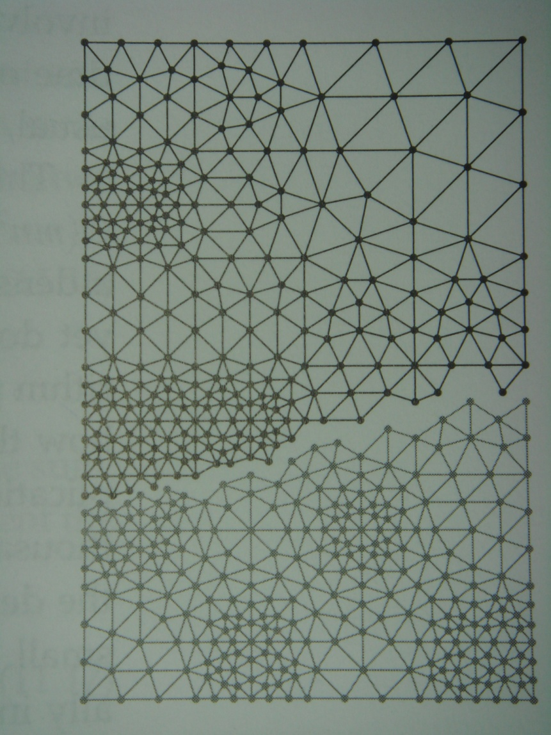
Spectral Partitioning
The best division found by spectral partitioning. The network is from Spectral Partitioning.

